Slide 1
Use Case Diagrams

Slide 2
What are they?
Use case diagrams are a high-level view of what a user might be doing when they use your system
Generally very quick to make, and will only deal with one or two steps

Slide 3

- This is an actor. This is any person, organization, or external system that plays a role in interacting with your system.

Slide 4

-This is a use case. This is a sequence of actions that a user would take when using your system

Slide 5
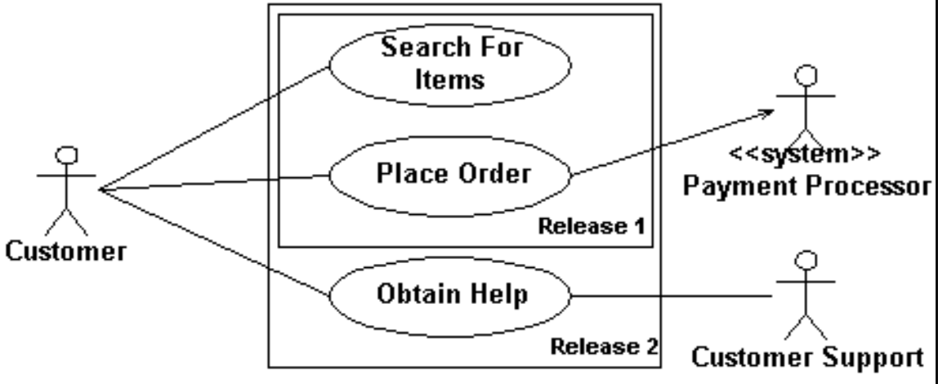
You may or may not place your use cases in a box. This box represents the system’s scope. Anything outside the box represents something that your system does not handle, or a separate actor.

Slide 6
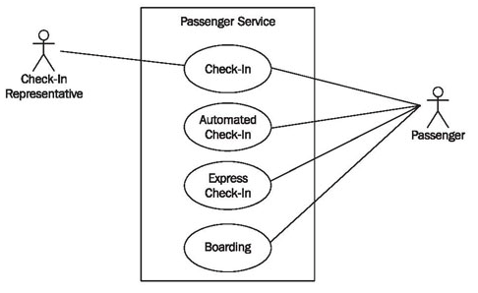

Slide 7
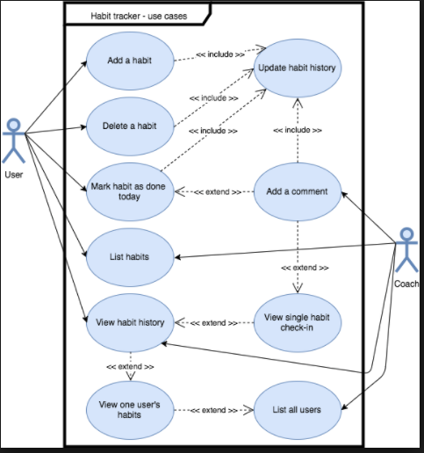

Slide 8
